Slide 1
Backups and Restoring Data with tar
5. 1 Archiving and Logging Data

Slide 2

Class Objectives
By the end of today’s class, you will be able to:
Identify and describe use cases for the three kinds of backups.
Create (tar) and archive from existing files and directories.
List and search the contents of an existing archive.
Extract the contents of an archive.
Describe and demonstrate two ways to exploit the tar command.

Slide 3
Archiving and Logging Data
In this unit, we’ll continue to explore how Linux system administrators use keep their system secure by:
Archiving data to ensure it remains available
in the case of a natural
disaster or cyber attack.
Scheduling backups to ensure they’re up to date and made at the appropriate frequency.
Monitoring log files to prevent and detect suspicious activity and keep systems running efficiently.

Slide 4


Archiving and Logging Data
These skills are used by system administrator to accomplish the following tasks:
Overseeing or conducting data backup and recovery.
Determining how long to retain data and the frequency of backups.
Monitoring and troubleshooting backups and restoration.
Providing security for compliance requirements.
Notes:
shutterstock_637453948

Slide 5
Archiving with tar

Slide 6

Archives are essential in IT security for maintaining regulatory compliance in industries like finance and health.
Notes:
Image source: shutterstock_1083618569

Slide 7
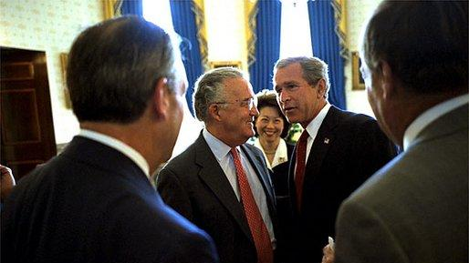

Finance
In finance, the common standard for data archiving is the Sarbanes-Oxley Act (SOX). It requires all business records
and communication to be retained for
five years.
Before the signing ceremony of the Sarbanes–Oxley Act, President George W. Bush meets with Senator Paul Sarbanes, Secretary of Labor Elaine Chao and other dignitaries in the Blue Room at the White House on July 30, 2002
Notes:
Image source: public domain

Slide 8






Finance
The Markets in Financial Instruments Directive (MiFID II) requires the European Union's financial firms to retain and reproduce records of all activity from telephone conversations and electronic
communications, including instant
messages and social media
interactions.
Notes:
Image source: shutterstock_791500798

Slide 9

Health
The most common standard is Health Insurance Portability and Accountability Act (HIPAA), which requires healthcare providers to keep records for six years.
Notes:
Image source: shutterstock_476686033

Slide 10
Introduction to the tar Command

Slide 11

Cyber professionals must ensure that data is always protected against threats of data loss and interruptions caused by attacks or natural disasters.

Slide 12
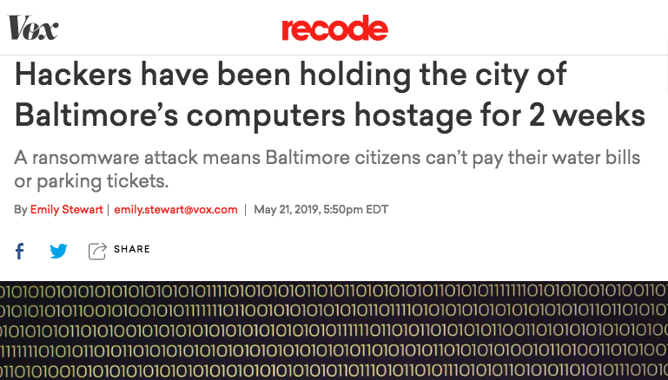
Ensuring Availability of Data
When important institutions are under threat, data must remain available.
In 2019, hackers seized important government machines during a ransomware Attack in Baltimore, Maryland.
vox.com

Slide 13

Ensuring Availability of Data
When important institutions are under threat, data must remain available.
In 2019, Hurricane Michael caused massive flooding, destroying homes, businesses, and strategic defense data at Tyndall Air Force Base.
Source

Slide 14

Backing Up Data
System administrators backup data so organizations can quickly recover lost assets and quickly restore systems.
A hard drive backup is a saved version of files on a disk at a given point.
A backup saves every single file on your system and copies it to a safe secondary place.
Performing regular backups is a top priority for organizations.
Backups are generally completed hourly or daily.
Notes:
Image source: shutterstock_1276756537

Slide 15


Types of Backups
There are three different types of backup: full, incremental, and differential.
Full backups are more reliable and offer complete restoration , but require large storage space.
Incremental and differential backups include only data that changed since the last full or incremental backup. They are fast and use less disk space.
Notes:
Image source: shutterstock_16534672

Slide 16
Performing a Backup

Slide 17


tar
The tar command is a Linux utility that system administrators use to create a backup.
tar (tape archive) takes files we want to back up and creates an archive of them.
An archive is a special file that contains a concatenation of files and directories.
Archives created with tar are called Tarballs and use the extension .tar.
Notes:
shutterstock_1296644836

Slide 18

Creating an Archive
The general syntax of the tar command is:
Let’s apply this command to following scenario:
The Systems Operations Center at Tyndall Air Force Base is backing up all system data with the approaching threat of Hurricane Michael.
tar [option(s)] [archive_name] [objects_to_archive]
Notes:
Image source: shutterstock_712360414

Slide 19
Creating an Archive
Create a full backup of all log files in /var/log using the tar command:
sudo tar cvf hurricane-backup-10-11-2018.tar /var/log
sudo because /var/log contains system files, we'll need administrator rights in order to make a backup of them.
It would compromise security if non-administrative users were able to make backups of system files.
Notes:
Image source: shutterstock_712360414

Slide 20
Creating an Archive
Create a full backup of all log files in /var/log using the tar command:
sudo tar cvf hurricane-backup-10-11-2018.tar /var/log
tar is the Linux command to initiate the backup.
Notes:
Image source: shutterstock_712360414

Slide 21
Creating an Archive
Create a full backup of all log files in /var/log using the tar command:
sudo tar cvf hurricane-backup-10-11-2018.tar /var/log
cvf are short form options.
c | stands for create. Always needed when creating an archive.
v | stands for verbose. It will print progress status and useful information as it’s running.
f | indicates the title of the archive.
Notes:
Image source: shutterstock_712360414

Slide 22
Creating an Archive
To create a full backup of all the log files in /var/log directory, use the following tar command:
sudo tar cvf hurricane-backup-10-11-2018.tar /var/log
hurricane-backup-10-11-2018.tar is the archive name, indicating the title.
Notes:
Image source: shutterstock_712360414

Slide 23
Creating an Archive
To create a full backup of all the log files in /var/log directory, use the following tar command:
sudo tar cvf hurricane-backup-10-11-2018.tar /var/log
/var/log are the objects to archive, indicating the files or directories we want to backup.
Notes:
Image source: shutterstock_712360414

Slide 24
Run the tar Command

Slide 25
Compressing archives with gzip
gzip is a command used to create a compressed tar archive, indicated with a tar.gz extension
gzip compression is useful when disk space is an issue.
Additionally, moving smaller files sizes uses less bandwidth, making transfer times faster.
gzip 2018-10-12-hurricane-backup.tar will compress the archive with a .gz extension.
gunzip 2018-10-12-hurricane-backup.tar will unzip an archive and remove the .gz extension, restoring the archive back to its original state.

Slide 26
Tar: Best Practices
In order to maintain confidentiality, privacy, and integrity:
When creating archives, be sure they are not writable by an untrusted user.
Inspect all data, such as passwords, before writing to an archive.
Pay attention to diagnostic and
exit status of tar.
Notes:
Image source: shutterstock_1276756537

Slide 27
Restoring Data with tar

Slide 28

Case Study: Backing Up Hackensack
In 2019 Hackensack Meridian Health systems were compromised by a ransomware attack.
The attack crippled computer systems and forced hospitals to reschedule surgeries and appointments.
The attackers offered to decrypt the data in exchange for payment, effectively ransoming the hospital’s data.
Unfortunately, the hospital was not prepared and had to pay the attackers.
Notes:
Source: https://threatpost.com/ransomware-attack-new-jersey-largest-hospital-system/151148/

Slide 29
Case Study: Backing up Hackensack
In this demonstration, we’ll respond to a similar ransomware attack that hit hospital systems on the morning of May 11, 2019.
Among the affected systems were:
Doctors
Patients
Treatments
After taking the infected systems offline, we'll need to:
Restore the operating system and applications using the full backup.
Restore email data using the full backup.
Restoring the email data will require using the tar command in order to:
List the contents of the latest full backup to locate the email data.
Extract the email data from the archive to a directory on the new system.

Slide 30
Medical Center Scenario

Slide 31
Activity: Creating and Restoring Data with tar
In this activity, you will use the tar command to create incremental backups and restore lost files.
25 Minutes

Slide 33
Incremental Backups with tar

Slide 34

The file sizes for full backups are very large, because they include everything on a system.
Depending on the size of the file system, doing a full backup takes a very long time.
Notes:
Image source: shutterstock_1043622175

Slide 35


Incremental Backup
Incremental backups are completed after a full backup is performed on a system, only capturing what has changed since the last incremental backup.
Incremental backups store a list of which files have changed in a snapshot file, with the extension .snar.
The snapshot is created when the admin creates the initial level 0 backup.
Every time an incremental backup completes, a new snapshot is created that contains only files that have
changed since the last full or incremental
backup.
Notes:
Image source: shutterstock_1234941118

Slide 36
Incremental Backup
Incremental backups are completed after a full backup is performed on a system, only capturing what has changed since the last incremental backup.
Incremental backups have the following drawbacks:
Restoring is slower. You must restore the latest
full backup, plus all the previous incremental backups.
There may be a loss of data if a single backup is corrupted.
You must verify an archive was created with no errors, using the tar W option.

Slide 37
Creating the Incremental Backup
In this section, we will to use tar in order to create incremental backups:
An incremental backup is a special form of a tar archive.
tar stores additional metadata or information so that the exact state of the file system can be restored when extracting the archive.
The additional information includes which files have been changed, added, or deleted since the last backup, so that the next incremental backup will contain only modified files.
The additional information is stored in a snapshot file.

Slide 38
Incremental Backup
$ tar cvvWf emerg_back_sun.tar --listed-incremental=emerg_backup.snar --level=0 emergency
--listed-incremental=emerg_backup.snar indicates this backup will be part of a series of incremental backups, and specifies that information about files added, changed, or removed should be stored in a snapshot file called emerg_backup.snar.

Slide 39
Incremental Backup
$ tar cvvWf emerg_back_sun.tar --listed-incremental=emerg_backup.snar --level=0 emergency
Since this is the first backup in the series, it is both a full backup and an incremental backup. This is because the first backup in a series of incrementals is basically a full backup, also known as a level 0 backup. Every succeeding backup will be much smaller than this one.

Slide 40
Incremental Backup Scenario
We’ll use the following scenario to demonstrate incremental backups:
Sunday | Monday | Tuesday | Wednesday
A hospital's system operations staff performs a full backup of all the data in the emergency database. | The staff runs an incremental backup which stores all changes made on Monday. This backup is smaller than the full backup. | An incremental backup archives only the changes made on Tuesday to the emergency database. | The hospital is hit with a ransomware attack and all the data in the emergency database is encrypted.

Slide 41

Fortunately, the hospital had created full and incremental backups and the files in the emergency database are easy to restore.
Notes:
Image source: shutterstock_1213753120

Slide 42
Incremental Backup Scenario
We’ll use the tar command to complete the following steps:
01
Create a full backup of the emergency directory and a snapshot file.
02
Display the contents of the level 0 backup.
03
Create the incremental backups generated on Monday and Tuesday.
04
Remove the emergency directory to mimic the ransomware attack on Wednesday.
05
Restore the emergency directory.

Slide 43
Incremental Backups

Slide 44
Activity: Restoring Data with Incremental Backups
In this activity, you and a partner will work as junior admins tasked with restoring the incremental backup of the patient files in a test environment.
20 Minutes

Slide 46

Notes:
Image source: AdobeStock_56885471

Slide 47
Exploiting the tar Command with the Checkpoint and Wildcard Options

Slide 48

Hackers can combine the tar command with the wildcard character (*) and the checkpoint feature to plant malware on a system.
Notes:
Image source: Dani Player

Slide 49
Using Wildcard with tar
Previously, we used the wildcard character (*) when creating an archive.
cd ~/Documents/ExploitTar
ls
f1
f2
f3
f4
f5
f6
f7
f8
f9
‘important docs’
tar cvf archive.tar ./*
Sysadmins use the wildcard symbol (*) to specify multiple files in a directory without having to type each filename.
For example, the command tar cvf archive.tar ./* would archive the contents of Documents/ExploitTar.

Slide 50
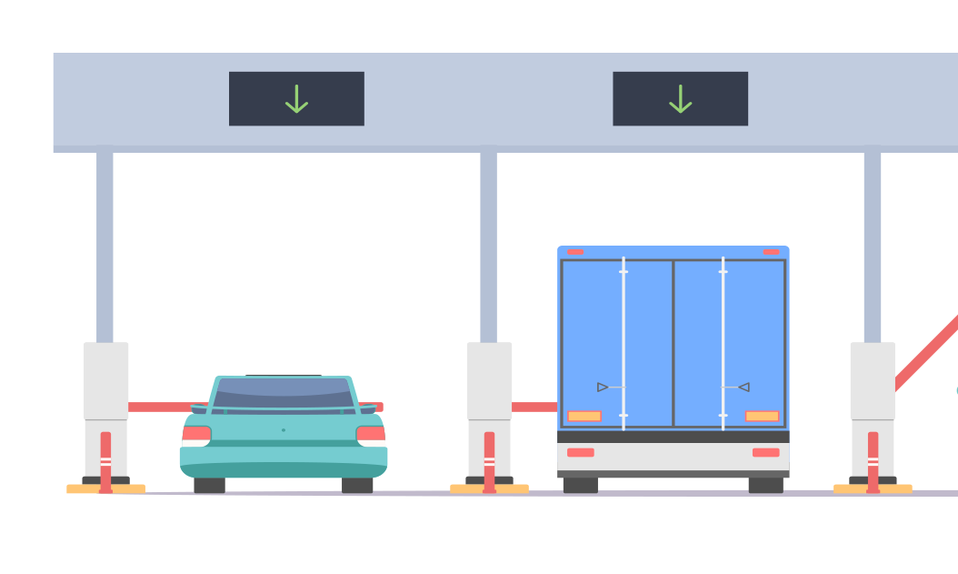
Using Checkpoints
A checkpoint is a specific stage of a backup or restoration that can trigger designated actions.
For example:
Once the backup reaches 1000 files, a checkpoint triggers the backup to pause and display the amount of remaining disk space.
When restoring files from a remote site, a message will print the number of bytes transferred every 5000 files.
The action taken and the frequency will vary based on the circumstance.
Notes:
Image source: shutterstock_1437130214

Slide 51
Using Checkpoints
Including checkpoints in our backup and restoration process is a best practice.
It allows administrators to avoid serious issues, such as accidentally using up all of the space on the backup server, or slowing down the network—both of which can damage data availability.
Notes:
Image source: shutterstock_1437130214

Slide 52
Using Checkpoints
Checkpoints involve two commands. The first defines the checkpoint, and the second specifies the action to be taken at that checkpoint.
For example:
--checkpoint=1000 indicates how often the checkpoint occurs.
At every thousandth file an action will take place.
Syntax: --checkpoint=[n]
--checkpoint-action=du indicates the action that will take place:
du displays the available disk space on the machine.
Syntax: checkpoint=[ACTION]

Slide 53
Exploiting System Vulnerabilities
In the previous Linux unit, we learned how sysadmins harden systems against exploits.
01
02
03
When a weakness is found, hackers can exploit it by changing existing code or using their own code.
This is also known as arbitrary command execution (ACE).
ACE vulnerabilities are extremely dangerous. Attackers can exploit them to accomplish almost anything, including gaining root privileges, which allows them to completely compromise a machine.
For our example, hackers have discovered how to use the tar checkpoint option with a wildcard to plant malicious code on a system, which they can later run to gain root privileges on the machine.

Slide 54


Checkpoint + Wildcard Exploit
First, a hacker gains access to a system by impersonating a normal user.
Elevated privileges, access to sensitive data
Hacker
Normal User
Log in via stolen password
Normal user can’t access sensitive files, open network connections, or perform root privilege actions

Slide 55


Checkpoint + Wildcard Exploit
A normal user can typically download and execute files from the internet. If a file is malicious, it can compromise the system.
Elevated privileges, access to sensitive data
Hacker
Compromised User
Login via stolen password
Normal user can’t access sensitive files
Downloadable Python script, wildpawn.py, can exploit tar and gain root privileges.

Slide 56

Checkpoint + Wildcard Exploit
Unsuspecting admins with root privileges run a tar command containing a wildcard. This will create an archive containing the directory of the malicious script.
tar + wildcard
wildpawn.py plants three malicious files on the machine: one hidden, and two files with names like tar checkpoint commands.
Hacker can drop into root shell, gaining full access to system.
Sysadmin unknowingly creates archive containing planted malicious script.

Slide 57
Exploiting tar
But how do checkpoints and wildcards fit into this exploit?
When a hacker runs wildpawn.py, it creates three files.
The hacker is able to create these files even if they only have normal user privileges.
The files include a malicious hidden script called .webscript and two files whose names appear like checkpoint commands:
--checkpoint=1
--checkpoint-action=exec=sh .webscript
After adding the first file to the archive, tar will execute the malicious .webscript.

Slide 58
Exploiting tar

Slide 59
Activity: Exploiting tar
In this activity, you will play the role of a penetration tester hunting for vulnerabilities in a target system backup procedure.
Use the wildpwn.py tool to verify the vulnerability, then research two mitigation strategies to protect the server.
25 minutes

Slide 61
Questions?

